Slide 1

Exam AZ-301: Microsoft Azure Architect Design Crash Course
Tim Warner

Slide 2

Tim Warner
Based in Nashville, TN, US
MCT since 1997
MVP since 2017
Twitter: @TechTrainerTim

Slide 3

Tim Warner
Available for preorder
25-Nov-2019 pub date
timw.info/ms300
Safari Books Online

Slide 4
Course Materials
timw.info/az300

Slide 5
Day 1 of 2 Agenda
Introduction
Module 1: Determine Workload Requirements
Module 2: Design for Identity and Security
Module 3: Design a Data Platform Solution
Exam AZ-301 preparation/strategy

Slide 6
Day 2 of 2 Agenda
Module 4: Design a Business Continuity Strategy
Module 5: Design for Deployment, Migration, and Integration
Module 6: Design an Infrastructure Strategy
Exam AZ-301 certification strategy

Slide 7
Ground rules
Azure Architect is an expert-level certification
You should already know how to deploy and configure Azure resources
This is a "crash course"
We have six hours, and we'll need every minute
Five-minute break at midpoint
Please ask/answer questions and provide feedback in the Q/A panel, not the group chat

Slide 8
Tim's Certification Study Pyramid
Interdependence
Content knowledge
Practical application
Test-taking skills

Slide 9

Let's get to work!

Slide 10
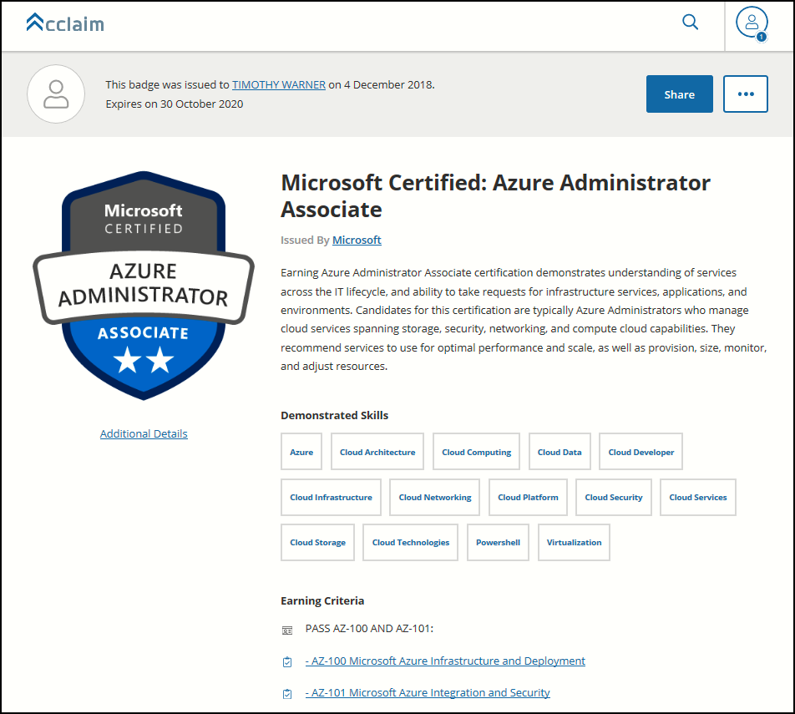
Digital Credentials by Credly/Acclaim

Slide 11
Exam AZ-301 Item Types

Slide 12
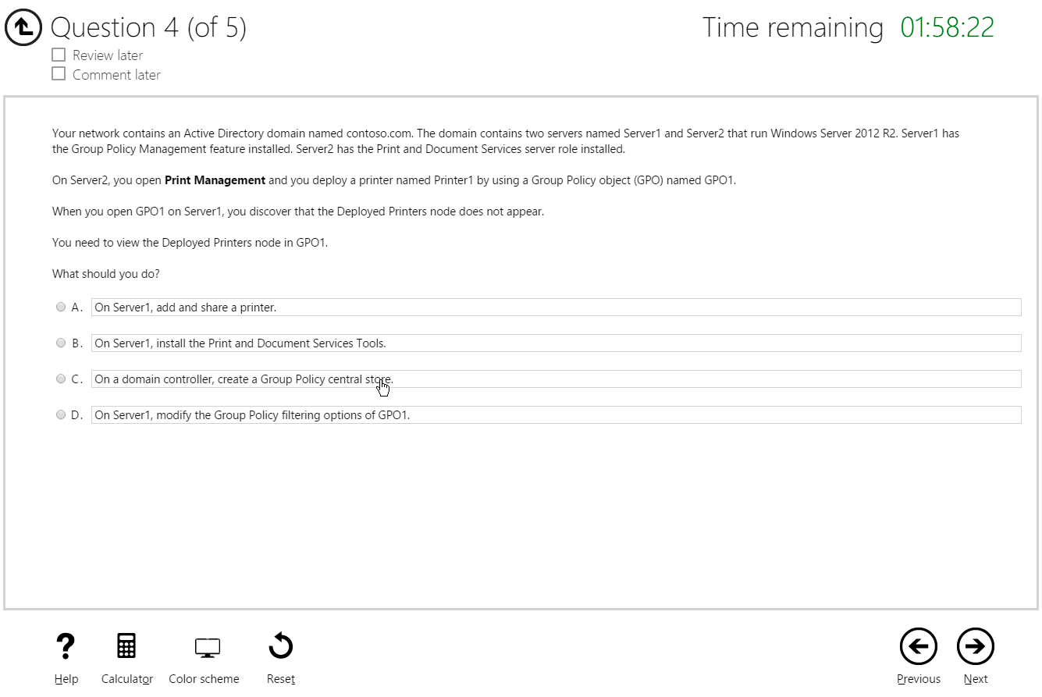
Multiple Choice

Slide 13
Repeated Scenario
You need to move an Azure VM to another hardware host.
Solution: You redeploy the VM.
Does this solution meet the goal?
Yes
No

Slide 14
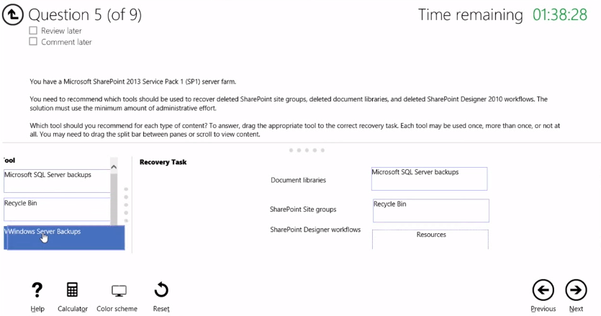
Select and Place

Slide 15
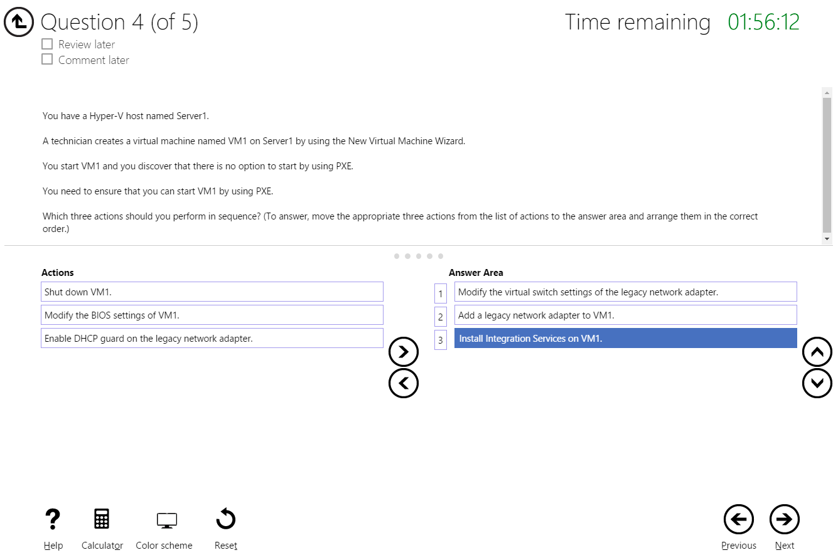
Build List and Reorder

Slide 16
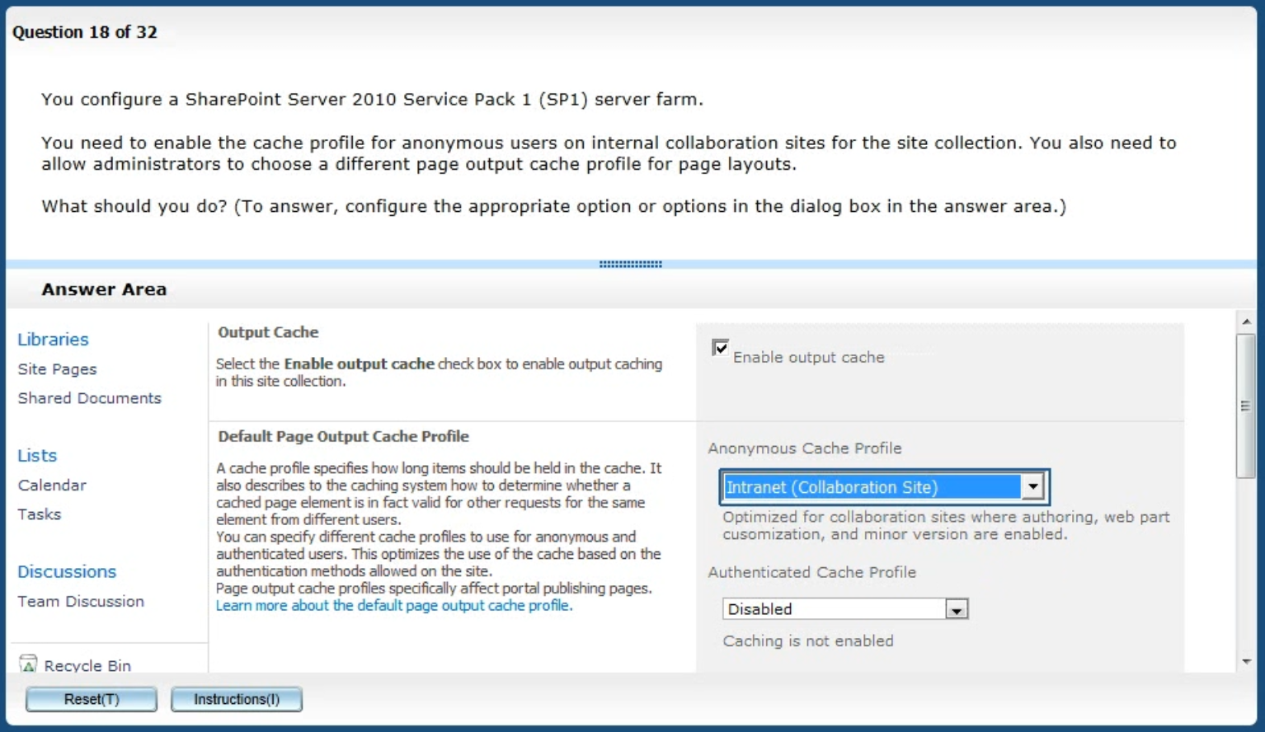
Active Screen/Fill in the Blank

Slide 17
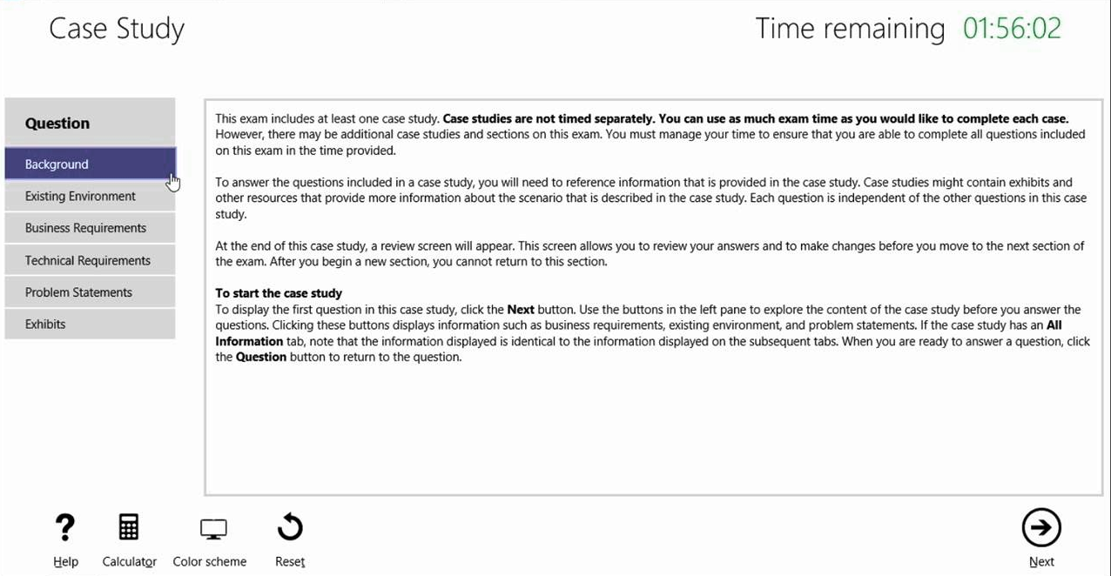
Case Study

Slide 18
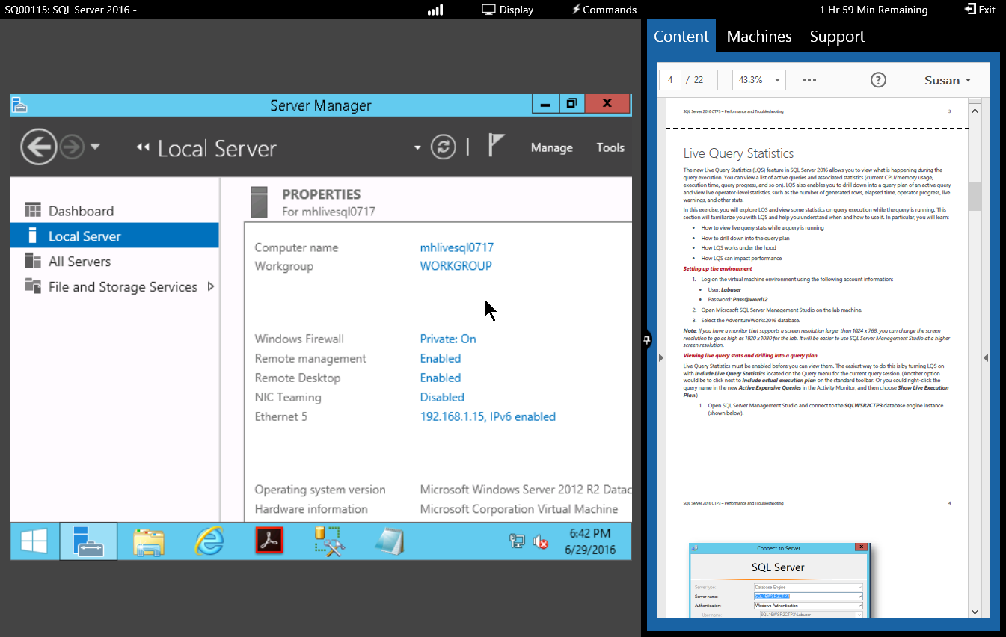
Performance-Based Lab

Slide 19
AZ-300 Exam Strategy/Tips
ARM API suggestion:
70 percent Azure portal
20 percent Azure PowerShell
10 percent Azure CLI
Expect to see lots and lots and lots of JSON
Performance-based labs
Open a second tab for shell.azure.com
Don't be afraid to file an item challenge/grievance

Slide 20
Thank you!
Course materials: timw.info/az300
Twitter: @TechTrainerTim
Work: Pluralsight.com
Web: TechTrainerTim.com

